Slide 1

OPER 623 – Heuristic Search Methods
Lesson 15
Ant Colony Optimization

Slide 2

Outline
Background – Real Ants
Artificial Ant Agents
Ant Systems
Overview
Initialization
Route Selection
Trail Updating
Ant Colony Optimization

Slide 3
Outline
Background – Real Ants
Artificial Ant Agents
Ant Systems
Overview
Initialization
Route Selection
Trail Updating
Ant Colony Optimization

Slide 4
Ant Communication
How Ants Comunicate? – YouTube
Ants - Secret of their communication revealed - YouTube
https://www.youtube.com/watch?v=5HKl8Luuotw
How Ants Sniff Out Food | ScienceTake - YouTube

Slide 5
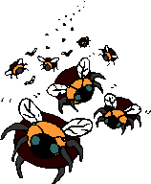

Swarm Metaheuristics
Ant Colony Optimization (ACO) is a classic type of “Swarm” Meta Heuristics
Ant Swarm, Bee Swarm, Bat Swarm, Particle Swarm…
What is swarm intelligence ?
“Swarm Intelligence (SI) is the property of a system whereby the collective behaviors of (unsophisticated) agents interacting locally with their environment cause coherent functional global patterns to emerge.”
“SI provides a basis with which it is possible to explore collective (or distributed) problem solving without centralized control or the provision of a global model.”
(Bonabeau et al: Swarm Intelligence : From Natural to Artificial Systems)

Slide 6
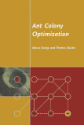
Historical Background
Developed by Marco Dorigo et al in early 1990s
M. Dorigo. Optimization, Learning and Natural Algorithms (in Italian). PhD thesis, Dipartimento di Elettronica, Politecnico di Milano, IT, 1992.
Inspired by the observation of real
ant colonies
social insects - live in colonies
behavior is directed more to
the survival of the colony
colonies can achieve high structuration
level compared to the relative simplicity
of the individuals
Structuration - the interrelation of parts in an organized whole

Slide 7
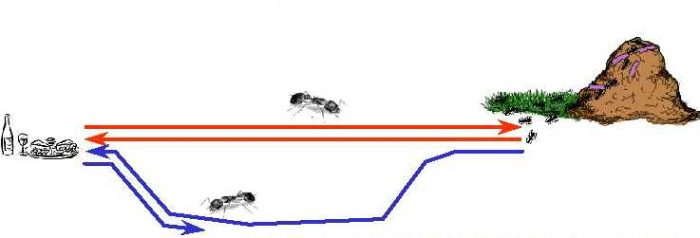
Real Ant Behavior
Foraging for food
While walking, ants deposit
pheromone forming a
pheromone trail
Ants can smell pheromone and choose paths marked by strong pheromone concentrations with higher probability
The pheromone trail allows the ants to find their way back to the food source (or to the nest)
Pheromone trail following behavior can give rise to the emergence of shortest paths
Pheromone - a chemical substance produced by an animal to serve as a stimulus to other individuals of the same species

Slide 8
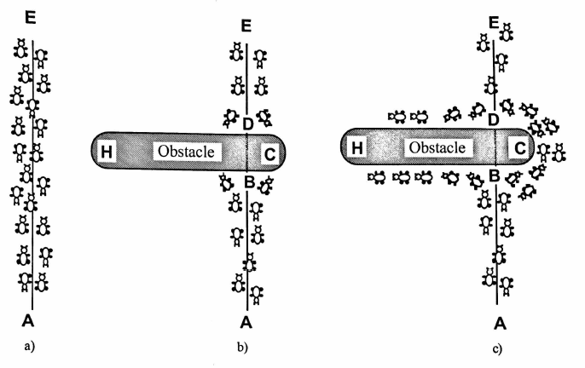
Real Ants
A large group of ants forage back and forth between nest A and food source E
An obstacle is placed in their path. Initially ants in both directions will split left or right taking paths DCB and DHB with roughly equal probability
The ants that chose path DCB will connect back to main path before the ants that chose path DHB. As a result the ants approaching the obstacle at D (equiv B) will see a stronger (2x) pheromone path along DCB versus the 1x path along DHB. Thus a higher probability of choosing path DCB will be created. Future positive reinforcement will quickly cause nearly all ants to choose this path.

Slide 9
Outline
Background – Real Ants
Artificial Ant Agents
Ant Systems
Overview
Initialization
Route Selection
Trail Updating
Ant Colony Optimization

Slide 10
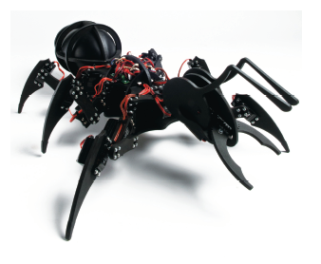
Artificial Ant Behavior
Have memory – Keep a list of where they have been
Have vision – Can see and judge neighbor distances
Move in discrete time steps
Secrete “pheromones” based on solution quality

Slide 11
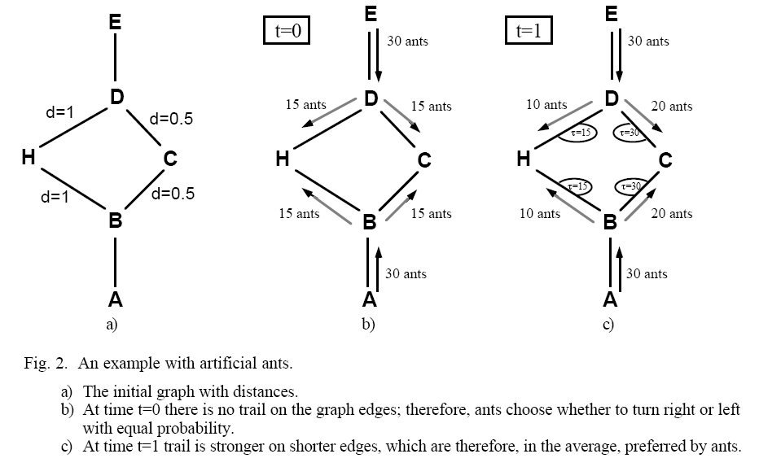
Artificial Ant Examp e
Given graph that represents obstacle, initialize all edges with constant pheromone level. Ant agents travel d=1 per time unit.
At t=0: 30 ant agents leave A and 30 ant agents leave B heading for E. Also 30 ant agents leave D and 30 ant agents leave E heading for A. The 30 ants at B split 50/50 so 15 take path BCD and 15 take path BHD (converse resp also)
At time t=1 the ants that chose path BCD arrive at D. Ants that chose DCB arrive at B. Thus Arcs CD and BC have pheromone levels of 30 each. Ants that chose BHD have only made it to H. Thus arcs BH and HD have pheromone levels of 15. As a result ants arriving at B will chose path BCD roughly 2x as often.

Slide 12
Outline
Background – Real Ants
Artificial Ant Agents
Ant Cycle
Overview
Initialization
Route Selection
Trail Updating
Ant Colony Optimization

Slide 13

Ant Cycle Overview
Mostly based on IEEE article by Dorigo (1996)
Classically applied to TSP
Each ant builds it’s own solution to the problem
Each ant collects information on problem characteristics and its own performance
Collective information is used to modify global representation of the problem
Ant Cycle exploits a positive feedback mechanism
Can utilize a distributed computational architecture (i.e., Parallel processing)

Slide 14
Ant Cycle Overview
START Ant Cycle
Locate ants. Each ant stores their
current city
on their own tabu list
Have the
maximum
Cycles been
performed
NO
YES
STOP
Ant Cycle
Each ant determines probabilistically (based on distance & pheromone lvls)
which city to visit next
Update pheromones
NO
Has every ant
visited every city
Each ant moves to next
city & adds this city
to their tabu list
YES
Record the length of
best ants tour and clear all tabu lists

Slide 15
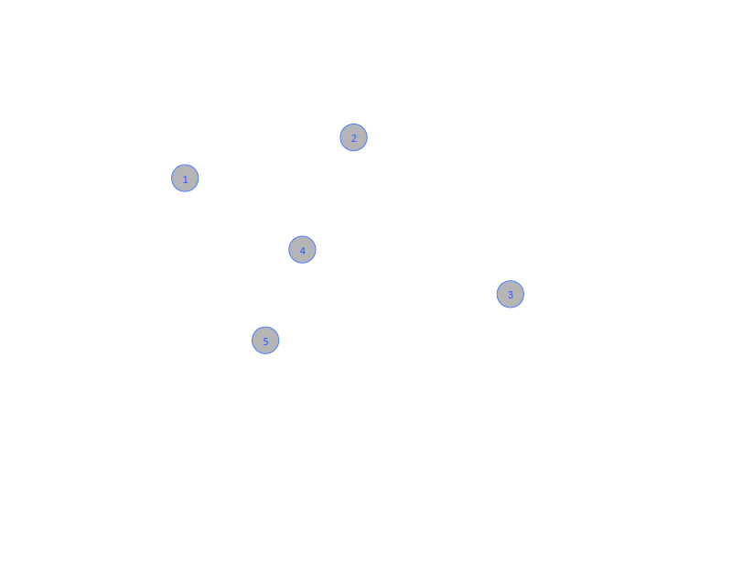
One Ant TSP Example
Given a Graph G = (V, E)

Slide 16
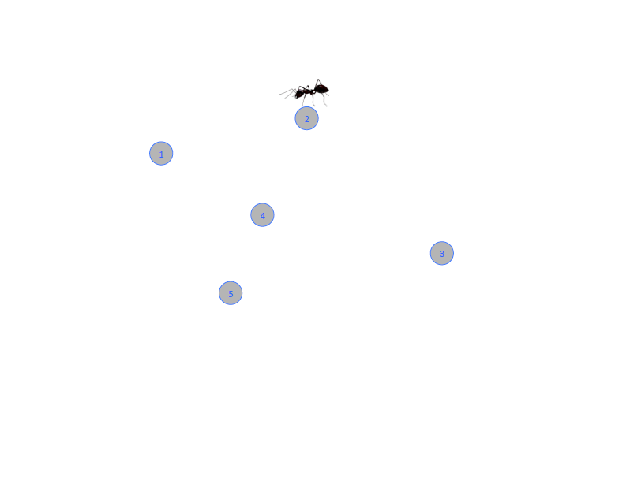
One Ant TSP Example
Randomly select a starting city for the ant, add city 2 to ants tabu list

Slide 17
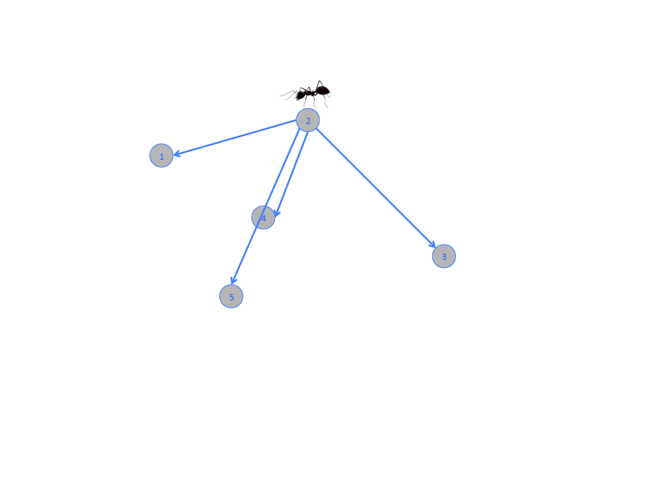
One Ant TSP Example
Initially all Pheromone levels are identical and only discriminator is distance

Slide 18
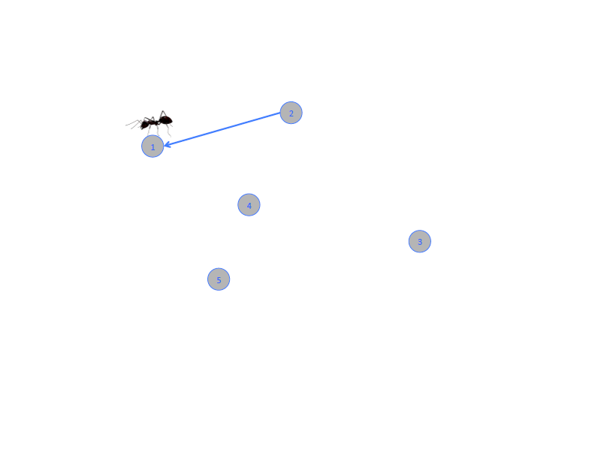
One Ant TSP Example
Choose a path probabilistically, add city 1 to ants tabu list
Once all ants have moved one arc that is one Iteration of Ant Cycle

Slide 19
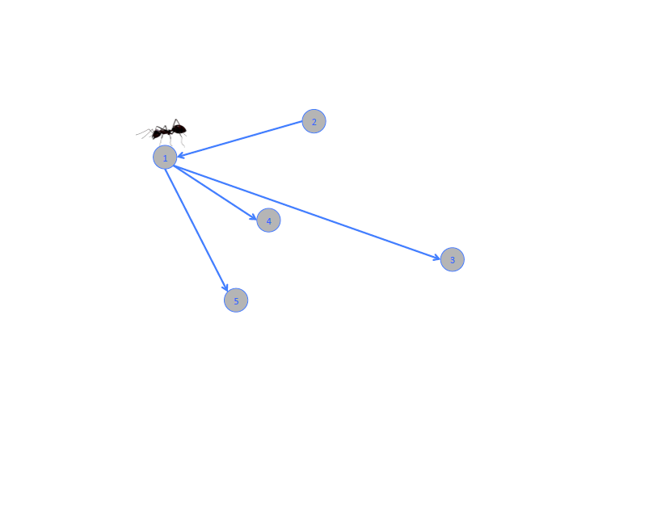
One Ant TSP Example
Can choose from cities not on tabu list

Slide 20
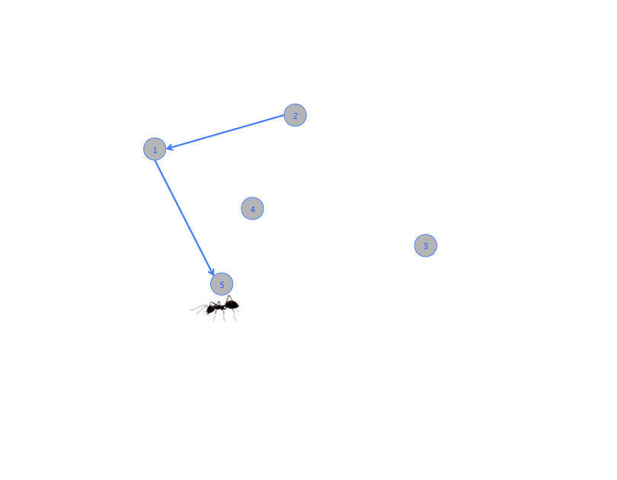
One Ant TSP Example
Choose a path probabilistically, add city 5 to ants tabu list

Slide 21
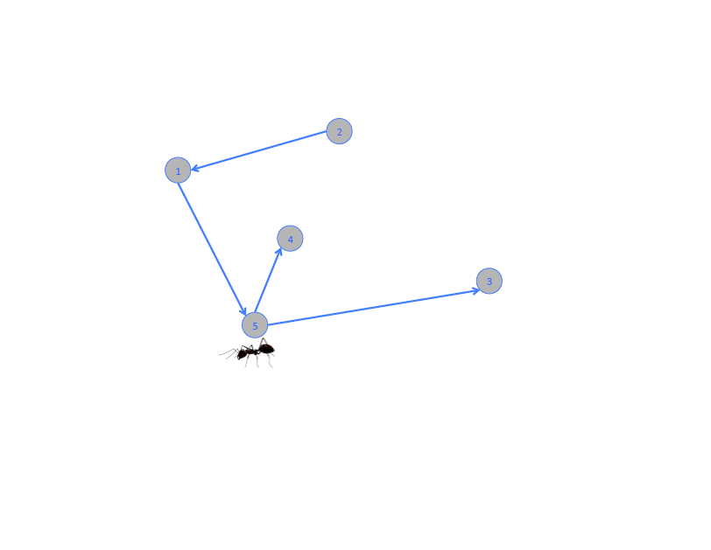
One Ant TSP Example
Can choose from cities not on tabu list

Slide 22
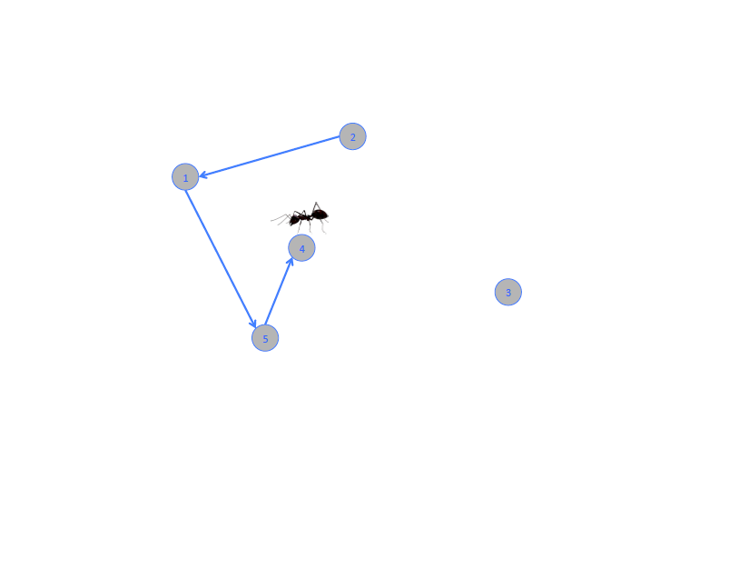
One Ant TSP Example
Choose a path probabilistically, add city 4 to ants tabu list

Slide 23
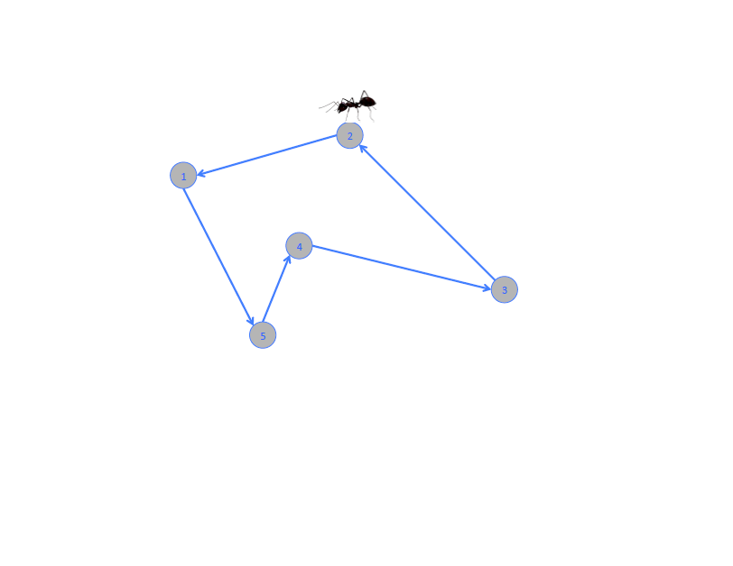
One Ant TSP Example
Complete tour, update cost This is one cycle of Ant Cycle

Slide 24

One Ant TSP Example
After tour is complete deposit pheromones along tour

Slide 25
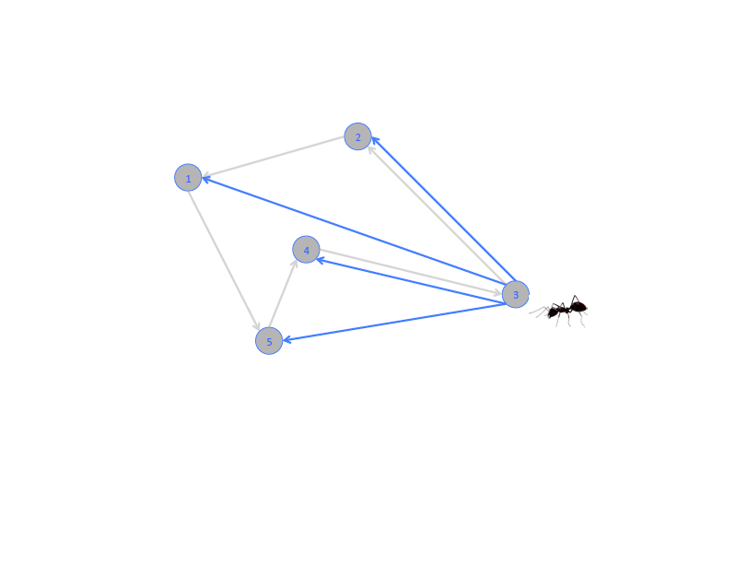
One Ant TSP Example
Randomly chose starting city, add city 3 to tabu list Can probabilistically choose path

Slide 26
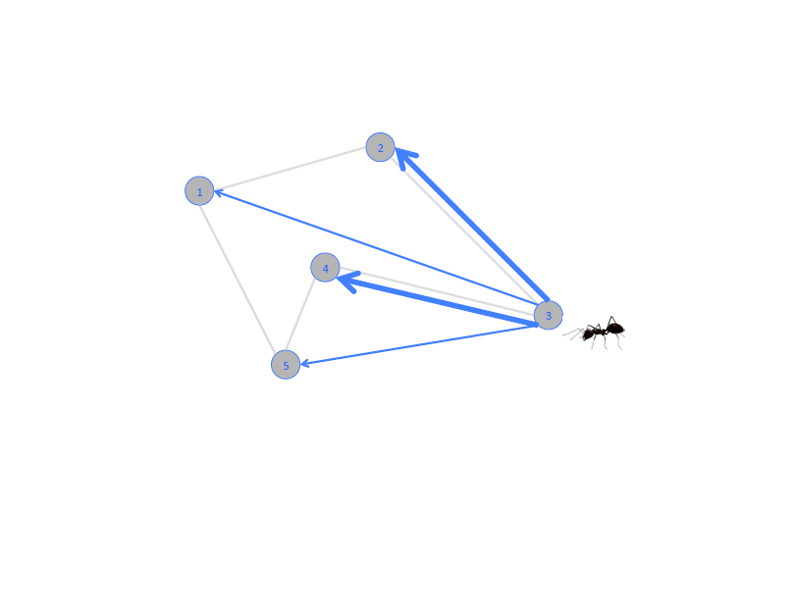
One Ant TSP Example
Shorter paths and paths with higher pheromone levels are preferred

Slide 27
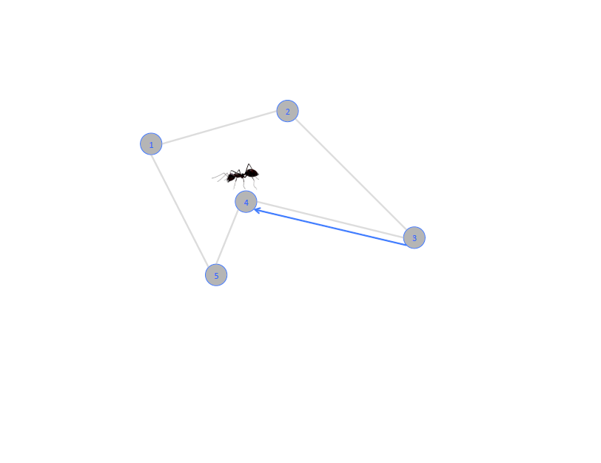
One Ant TSP Example
Choose a path probabilistically, add city 4 to ants tabu list

Slide 28
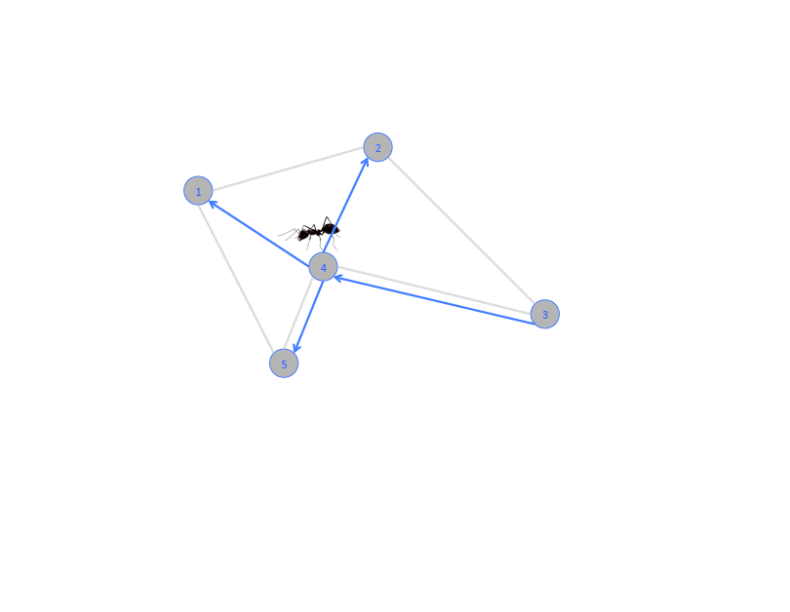
One Ant TSP Example
Can probabilistically choose path

Slide 29
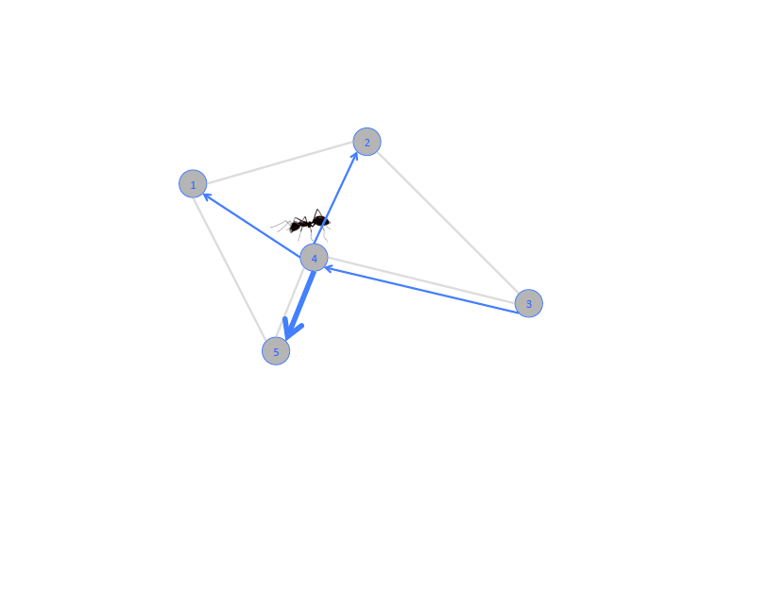
One Ant TSP Example
Shorter paths and paths with higher pheromone levels are preferred

Slide 30
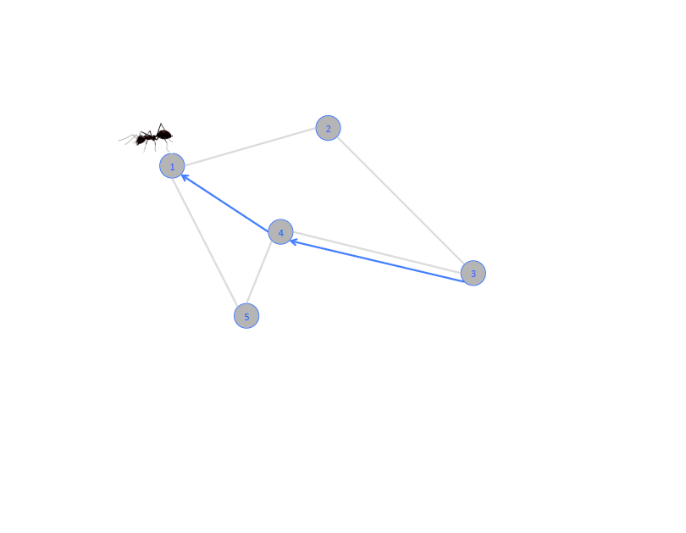
One Ant TSP Example
…but not guaranteed to choose preferred path! Probabilistically chooses path
Why is this important?

Slide 31
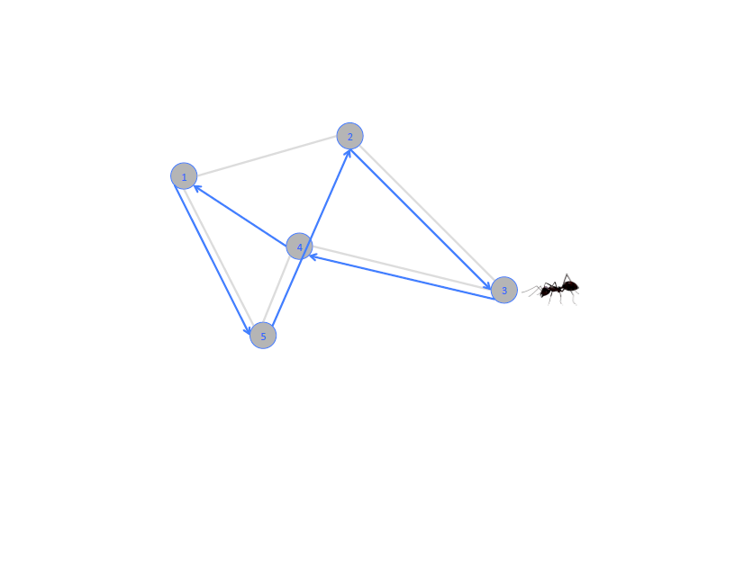
One Ant TSP Example
Completes tour in this fashion

Slide 32
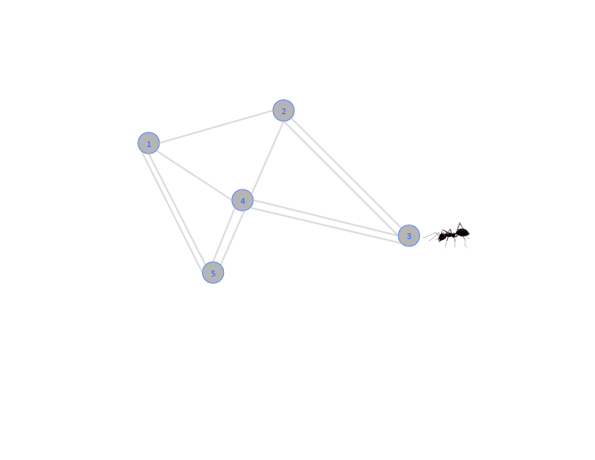
One Ant TSP Example
After tour is completed pheromone levels are incremented on paths used.

Slide 33
One Ant TSP Example
Old pheromone levels are also partially evaporated

Slide 34
Outline
Background – Real Ants
Artificial Ant Agents
Ant Cycle
Overview
Initialization
Route Selection
Trail Updating
Ant Colony Optimization

Slide 35
Ant Cycle Initialization
How many ants?
Approximately n …
Where should they start?
All in same city?
One in each city?
Randomly chosen cities?
How much pheromone to start with on each path?

Slide 36
Outline
Background – Real Ants
Artificial Ant Agents
Ant Cycle
Overview
Initialization
Route Selection
Trail Updating
Ant Colony Optimization

Slide 37
Ant Cycle Route Selection
Arc ij Pheromone impact
Arc ij Distance impact
Probability ant k chooses arc ij
Sum of Pheromone and Distance over allowed moves
τ_{ij} – amount of the pheromone on the trail segment (ij) – trail intensity
η_{ij} = 1/d_{ij} is the trail visibility
α – importance of trail intensity in the probabilistic transition
β – importance of trail visibility

Slide 38
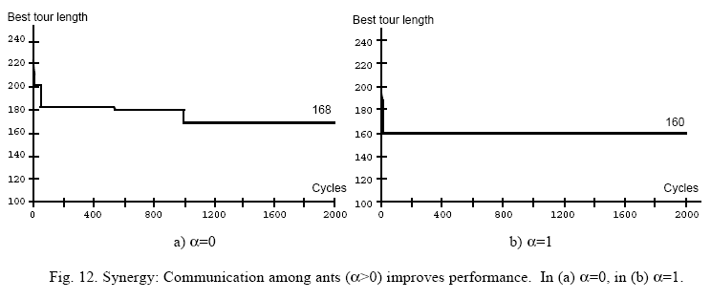
Ant Cycle Route Selection

Slide 39

Ant Cycle Route Selection
If $α$ is too high then future ants will only do what prior ants have done and no new tours will be explored.
If $β$ is too high then heuristic just becomes a greedy Nearest Neighbor variant and no new tours are explored.

Slide 40
Outline
Background – Real Ants
Artificial Ant Agents
Ant Cycle
Overview
Initialization
Route Selection
Trail Updating
Ant Colony Optimization

Slide 41

Ant Cycle Pheromone Addition
After each cycle pheromone is added to every arc (i,j) in ant_{k}’s tour, based on the length L_{k} of ant_{k}’s tour
Q – a constant controlling the amount of pheromone laid down
Then total addition of pheromone per arc is given by:
Change in pheromone level on arc ij due to ant k
Total change in pheromone level on arc ij

Slide 42
Ant Cycle Pheromone Evaporation
Evaporation is used to prevent stagnation of the search process (i.e premature convergence)
ρ – trail persistence (1 – ρ) is the evaporation rate
Typical values ρ = ~0.5
Thus, at end of each cycle total pheromone levels per arc (i,j) is changed as follows:
1

Slide 43
Outline
Background – Real Ants
Artificial Ant Agents
Ant Cycle
Overview
Initialization
Route Selection
Trail Updating
Ant Colony Optimization

Slide 44
Ant Colony Optimization
Ant Cycle, while revolutionary, was not competitive with state-of-the-art heuristics for TSP.
Researchers looked at ways to improve its performance.
These extensions form the broader umbrella of Ant Colony Optimization.

Slide 45
ACO Extensions
Elitist Strategy
Best-so-far tour reinforced each cycle regardless of if an active ant traveled it
Essentially creating e elitist ants that travel the best-so-far tour each cycle
Edges in the best tour are updated based on
eQ/L*
e is the number of elitist ants
L* is the length of the best-found tour

Slide 46
ACO Extensions
MAX - MIN Ant System (MMAS)
Sort the ants according to the lengths of the tours they generated.
Only the (w - 1) best ants from this iteration and the global best ant deposit pheromones each cycle.
The r^{th} best ant of the colony contributes pheromones with a weight given by max{0, w–r}.
The global best ant deposits pheromones with a weight of w.

Slide 47
ACO Extensions
Pseudo-random proportional rule
Select a probability q₀ in [0; 1].
With probability q₀ : The ant moves deterministically to the arc in which the product between heuristic information and pheromone trail is maximum.
With probability 1 - q₀ : The ant moves probabilistically according to the standard Ant Cycle probability (e.g., p^{k}_{ij}(t) from earlier slide)
If q₀ = 1 the greedy (maximum product of heuristic information and pheromone trail) is always selected.
If q₀ = 0 this extension collapses to simple Ant Cycle
Can change q₀ over time to favor intensification (larger q₀) or diversification (smaller q₀).

Slide 48
ACO Extensions
Strong Elitist
Only the ant that has produced the global best solution is allowed to update pheromone trails.
Cycle Best
Only the ant that has produced the cycles best solution is allowed to update pheromone trails.
Ant Eating
Ants eat the pheromone trail on the arcs they visit.
Decreases the probability that the same path is used by many ants

Slide 49
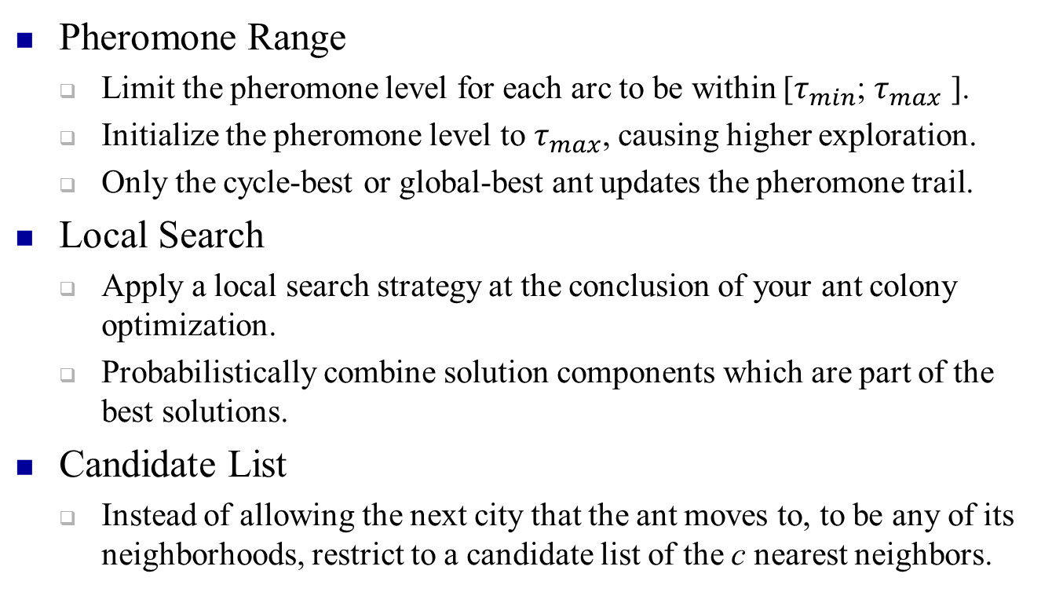
ACO Extensions
Pheromone Range
Limit the pheromone level for each arc to be within [$τ_{min}$; $τ_{max}$ ].
Initialize the pheromone level to $τ_{max}$, causing higher exploration.
Only the cycle-best or global-best ant updates the pheromone trail.
Local Search
Apply a local search strategy at the conclusion of your ant colony optimization.
Probabilistically combine solution components which are part of the best solutions.
Candidate List
Instead of allowing the next city that the ant moves to, to be any of its neighborhoods, restrict to a candidate list of the c nearest neighbors.

Slide 50
Ant Systems Applications

